Slide 1

Secretary + Treasurer
Officer Positions:
2012-2013 CDCKI Membership Development and Education Committee

Slide 2


Publishing a Club Directory
Sec.
Club Directory has the following:
Full Name
Position (if any)
Home Address
Phone Number
Email Address
Facebook Link
Birthday
Graduation Year and Major

Slide 3
Monthly Report Forms (MRFs)
Most important duty
Due on the 5th of every month for previous month at Midnight and emailed
Broken into sections
Club Adminstration
Membership Status
Club Meetings
District Administration
Club Spotlight
Member of the Month Spotlight
Kiwanis Family Relations
Fundraising
Officer Change Info
Public Relations
Misc.

Slide 4
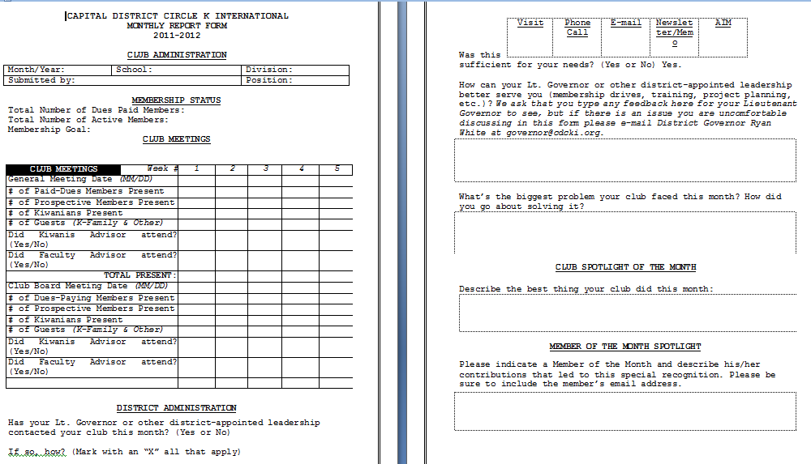
Monthly Report Forms (MRFs)

Slide 5
Duties and Responsibilities
Dues:
Collect and record
Forward dues, dues invoice, and membership form to the CKI Office
Send copies of the dues invoice & check to the District Secretary/Treasurer
Invoice members for unpaid dues
Prepare the club budget and ensure that club activities adhere to the budget.
Establish a book of accounts showing all financial transactions
Maintain accurate financial records
Inform the club of its financial strengths and weaknesses.
Inform and ask sponsoring Kiwanis Club for financial support/ status
Club funds
Deposit, collect, dispurse
Help coordinate fundraising projects with the fundraising committee and/or board of officers
Attend all meetings

Slide 6
Budgeting
Service Account
For Donations (funds to charities and service projects)
Administrative Account
Club Administration (running of club)
Buy supplies, purchase advertising, send members to conventions
Can be used for service if one pleases
From club dues, Kiwanis-Family members, college grants
Projects Account
Used to organize and execute the club’s service projects, socials, and fundraisers that require money to implement.

Slide 7
Fundraising
Determine how much funding you need
What will it take to accomplish your goals?
Choose the right project
Choose a project that will help fulfill your club’s goals.
Explain your cause
Let people know who will benefit from the fundraiser.
Be creative
Think of innovative ways to spark enthusiasm for your fundraiser.
Make sure the activity is worth the effort
Your project should be cost effective considering the time and effort exerted.
Get organized
Envision it from start to finish considering obstacles and anticipating income and expenses.
Publicize the event
Advertise to your campus with posters and ads in the school newspaper.
Get others motivated and excited about helping
A successful fundraiser cannot be successful without the support of the club.

Slide 8
Do you want to be a leader?
Run for any positions next year at DCON! District positions are open too! (LTG)
Talk to our president !!
Email, Facebook, Text/Call

